Slide 1

Structuring Content with WordPress
Abhishek Deshpande

Slide 2

About Me
Blogging since 2006
Statistic Graduate, 2007
Web mastering since 2008
Currently Working as Solution Architect at Peenak Solutions, Nagpur
@fitehal

Slide 3
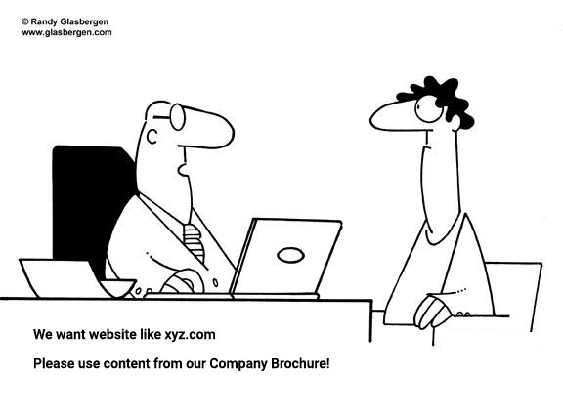
Problem we are discussing
@fitehal

Slide 4
Solutions?
@fitehal

Slide 5
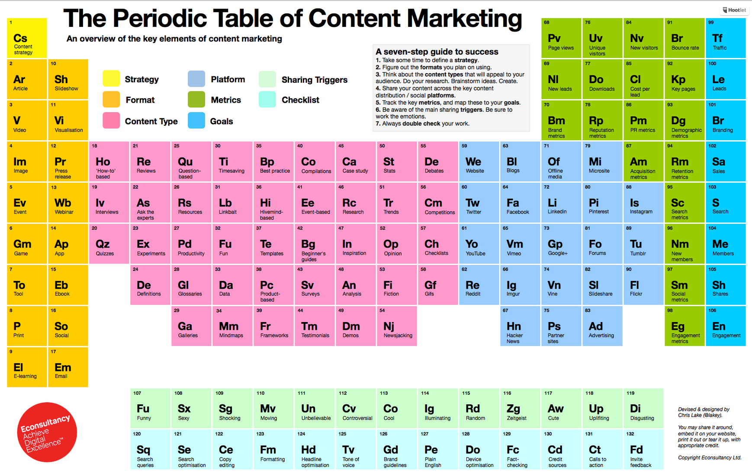
Notes:
Question based
Best Practices
Case Studies
Researches
Trends
Culture
Survey
Analysis
Demos
MindMaps

Slide 6
Why Content Model
To help Information architects and designers
To help Developers
To help Content Authors and Producers
@fitehal
Notes:
Information architects and designers make sure that the page designs accommodate all the content types for the site and provides guidance on the bits of text and media that will be available for the page.
Developers understand content needs and requirements as they configure the CMS
Content Authors and Producers gets guidelines on what content to write or create and how to enter it.

Slide 7
How do you create a content model?
Site Structure (Pages, Posts)
Content Types (CPTs) to Use
Content Meta data (Custom Fields & Taxonomies)
@fitehal

Slide 8
Question to ask for site structure
Do you need to capture specific, uniquely identifiable data?
How reusable does the content need to be?
@fitehal
Notes:
How structured does the content need to be? Do you need to capture specific, uniquely identifiable data that can be used to sort or filter the content (for example, date, price, rating, author, or location)?
How reusable does the content need to be? Can you make the reusable parts separate so that they can be shared across different pages of the site?

Slide 9
Why Custom Content Types
Distinct, reusable elements
Functional requirements
Organizational requirements
@fitehal
Notes:
- Distinct, reusable elements. You might decide to create an Author content type that contains the name, bio and photo of each author. These can then be associated with any piece of content that person writes.
- Functional requirements. A Video might be a different type of content because the presentation layer needs to be prepared to invoke the video player.
- Organizational requirements. A Press Release may be very similar to a general Content Page, but only the Press Release is going to appear in an automatically aggregated Newsroom. It’s easier for these to be filtered out if they’re a unique type of content.
How many differences does it take before something is a completely different thing?

Slide 10
Resources
@fitehal

Slide 11
Mind Mapping Tools
Xmind, Coggle, Freemind
@fitehal

Slide 12
Structured Data & Microdata
[Documentation] Schema.org
[Plugin] All In One Schema.org Rich Snippets
https://wordpress.org/plugins/all-in-one-schemaorg-rich-snippets/
[Tool] Structured Data Testing Tools - https://search.google.com/structured-data/testing-tool/u/0/
@fitehal

Slide 13
Custom Post Types
[Documentation] https://codex.wordpress.org/Post_Types
[Plugins] Toolset Types, Pods Framework,
[Code Generator] GenerateWP
@fitehal

Slide 14
Recap
Discuss with Client & understand requirements
Define Structure before Working on Content development
Use content in your predefined structure
@fitehal

Slide 15
Jai WordPress!
@fitehal
abhishek@peenak.com

